Slide 1

Clothing
NLP PROJECT
Jana 1201139-Ahmed 1200105-Lana 1200071

Slide 2
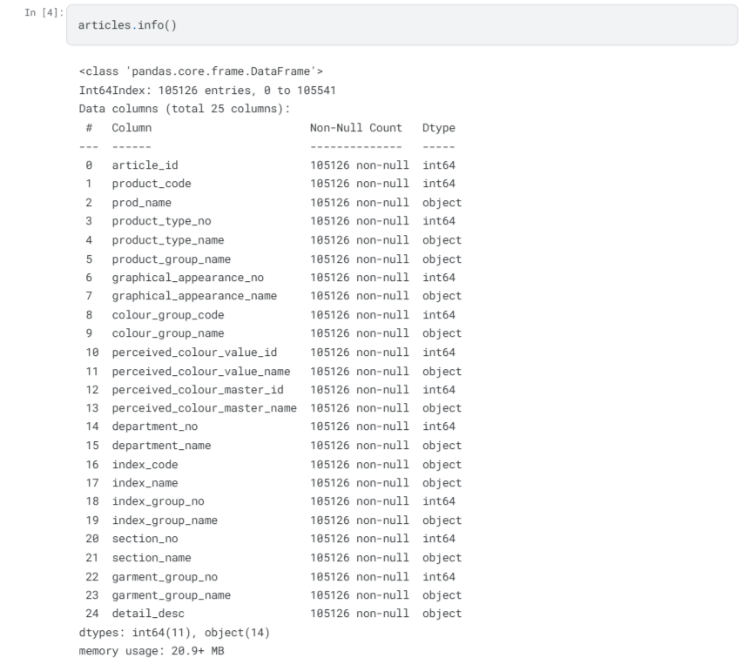
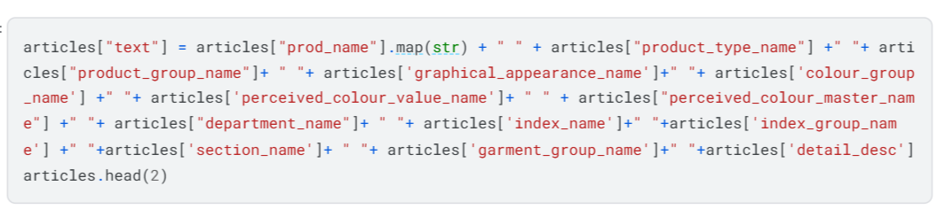
Importing Datasets
Articles Dataset
NLP-related variables were selected from the dataset and all those variables containing text were combined in one column with the name "text"

Slide 3
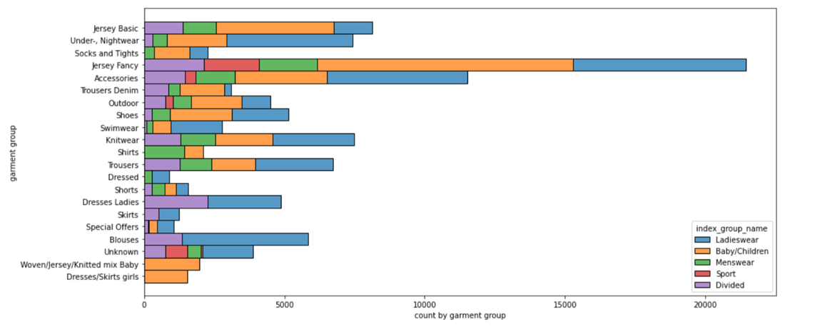
The garments grouped by index: Jersey fancy is the most frequent garment, especially for women and children. The next by number is accessories, many various accessories with low price.
The garments grouped by index: Jersey fancy is the most frequent garment, especially for women and children. The next by number is accessories, many various accessories with low price.

Slide 4
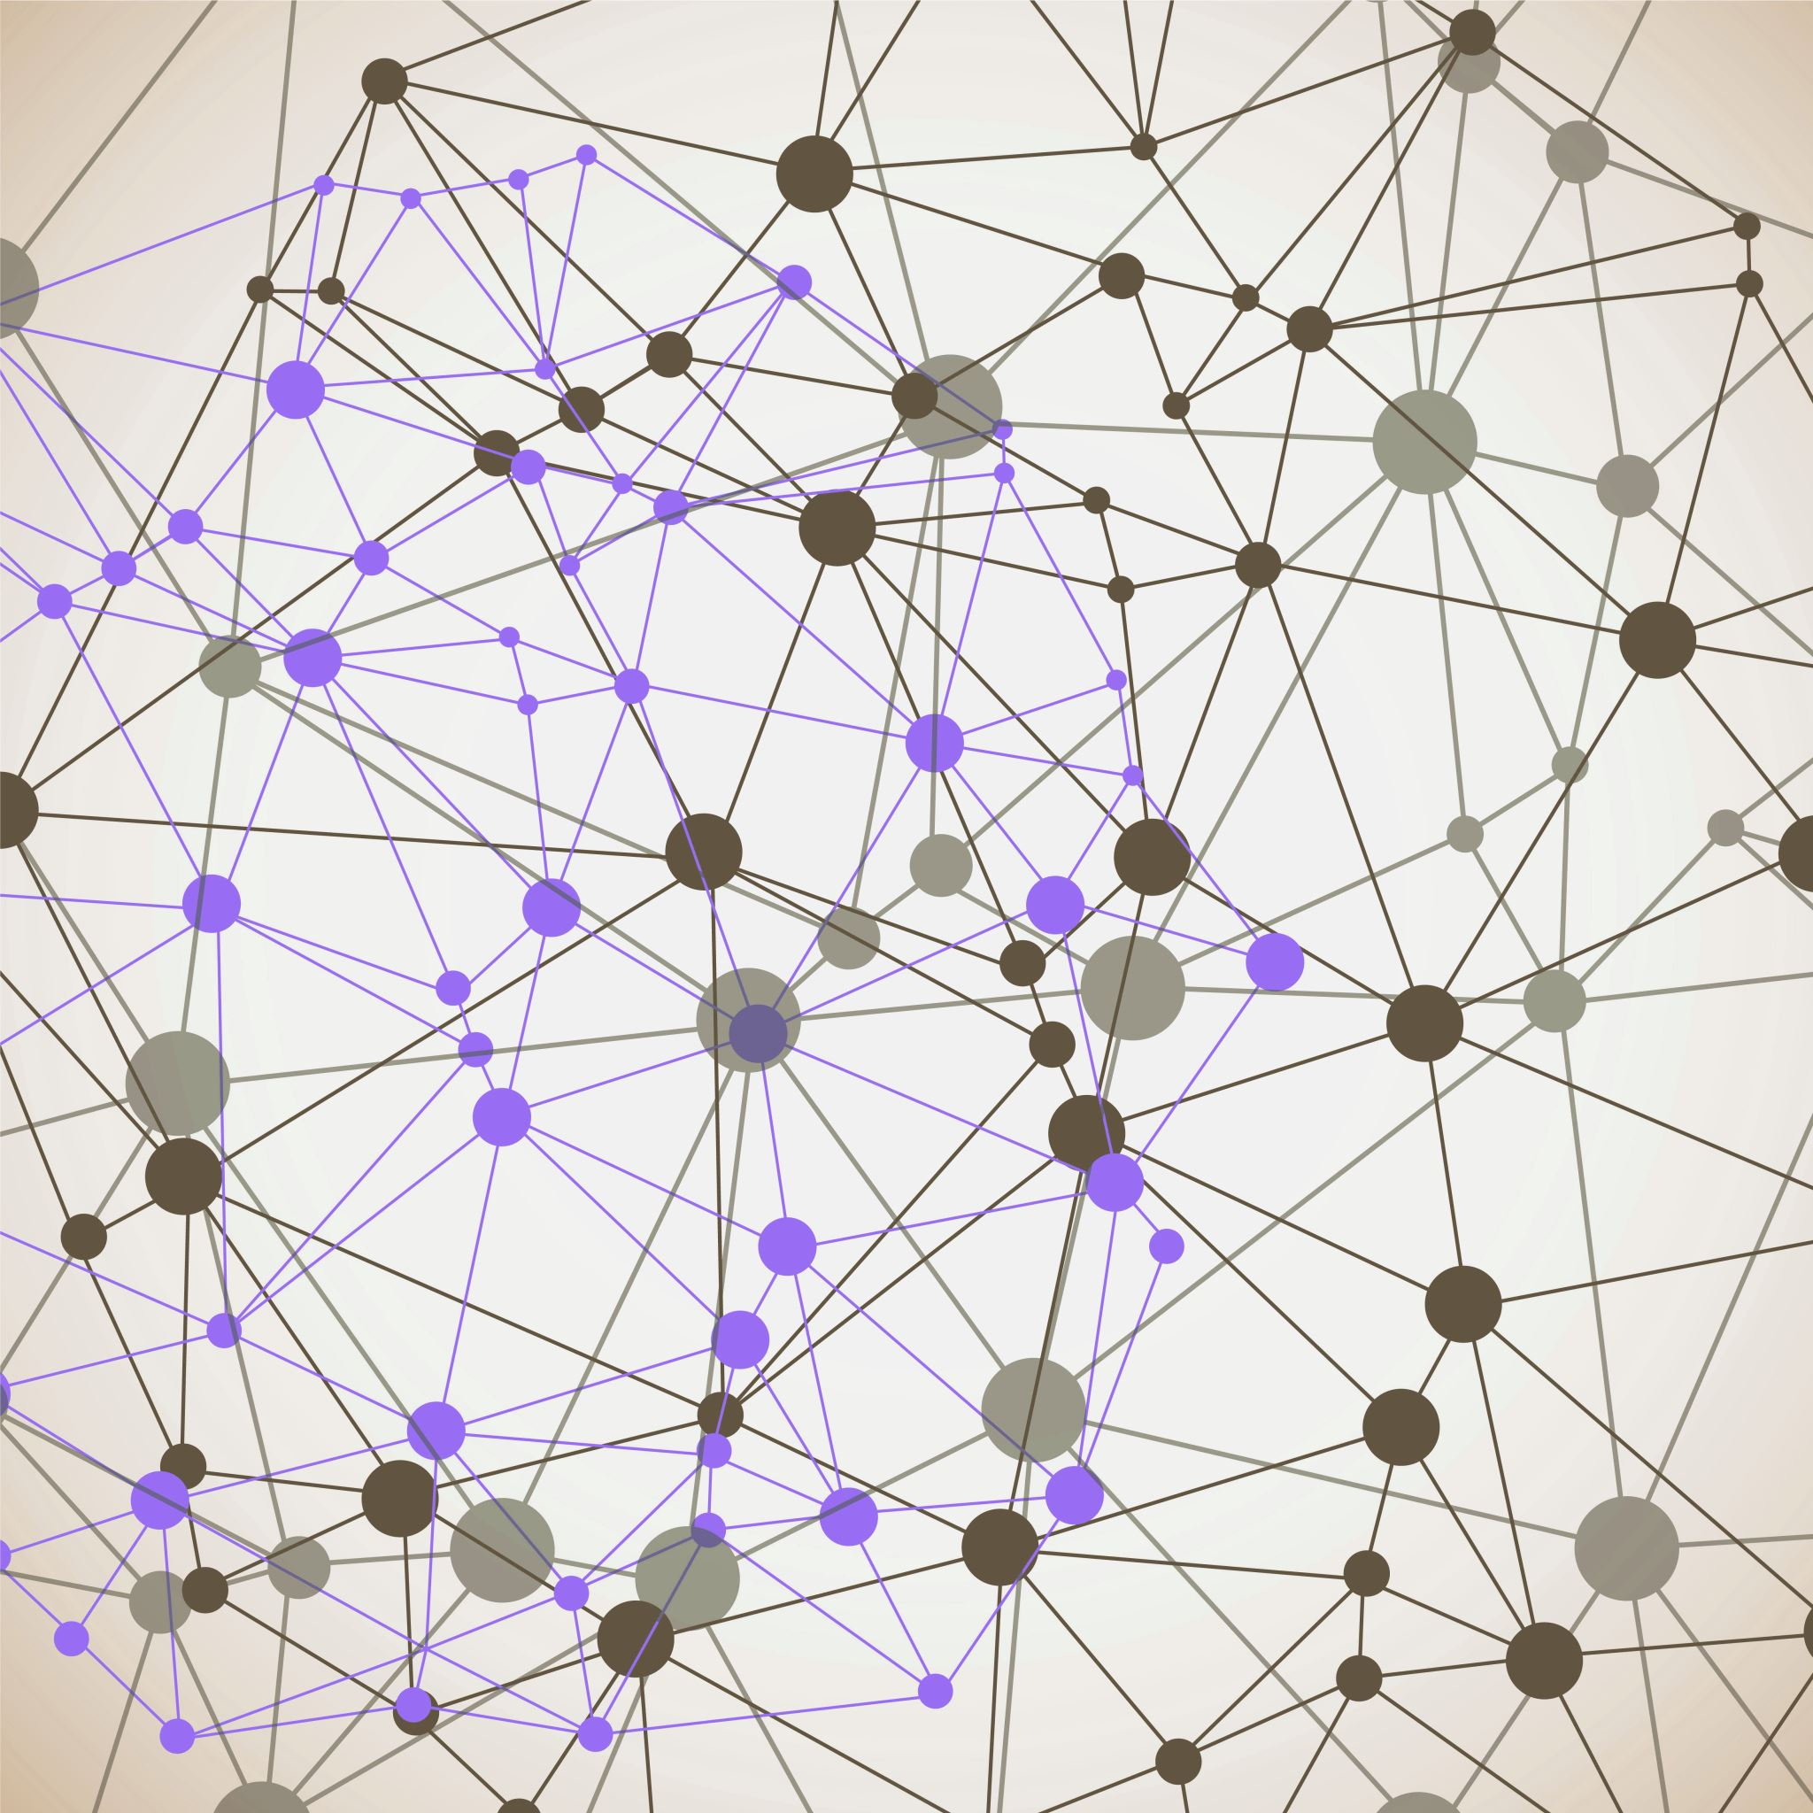
Reprocessing
The Corpus

Slide 5
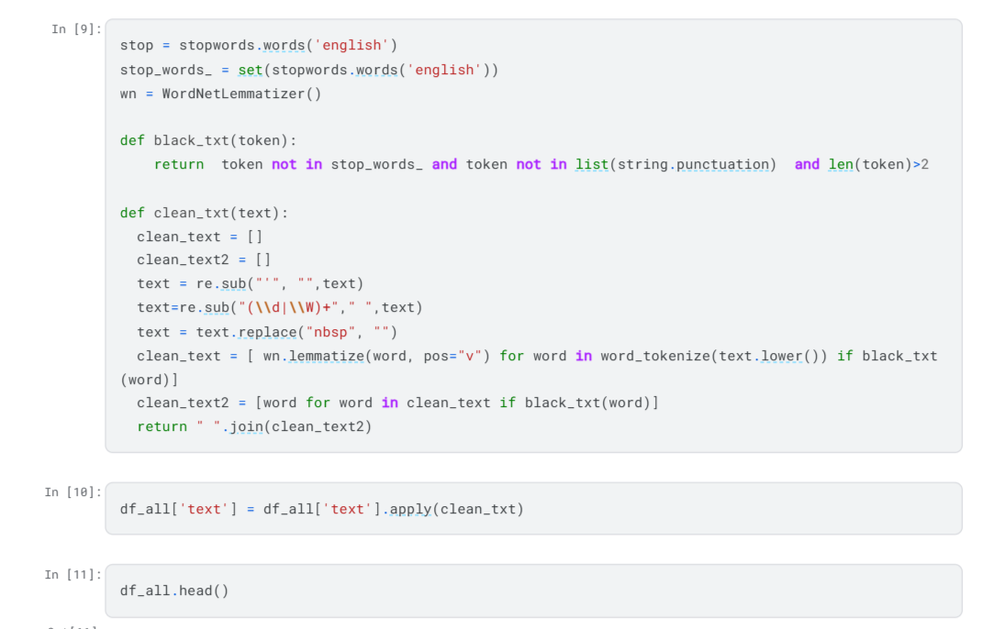
Stop words Removal
Token Filtering
Text Cleaning
Lemmatization

Slide 6

Loading Customers and transactions

Slide 7
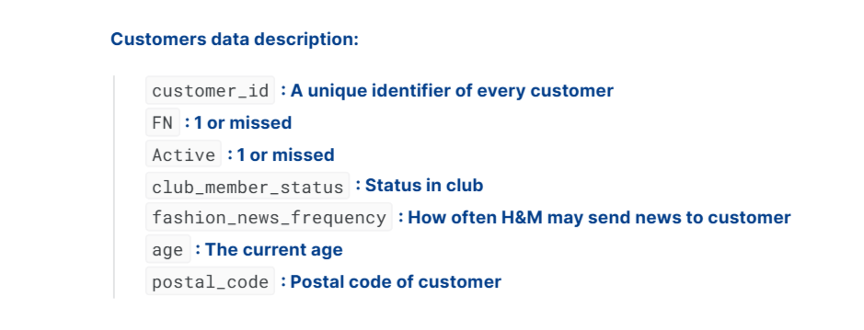
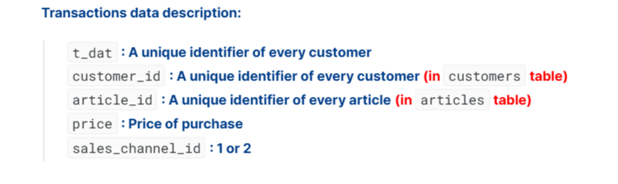

Slide 8

Merge transactions with
Article ID & Customer ID

Slide 9
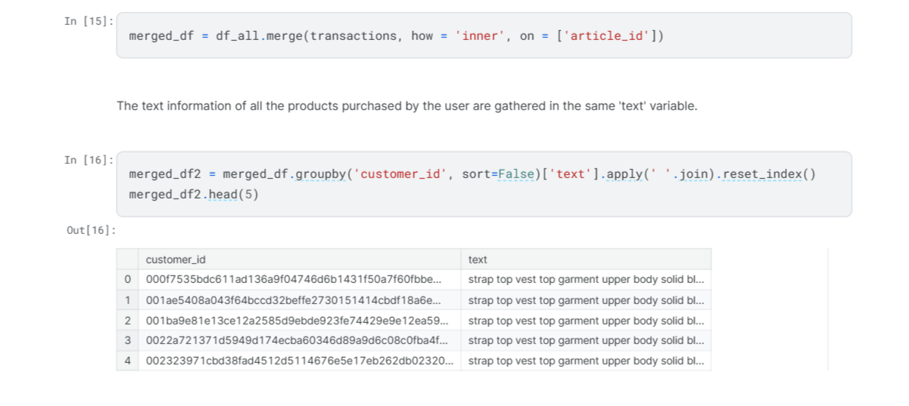
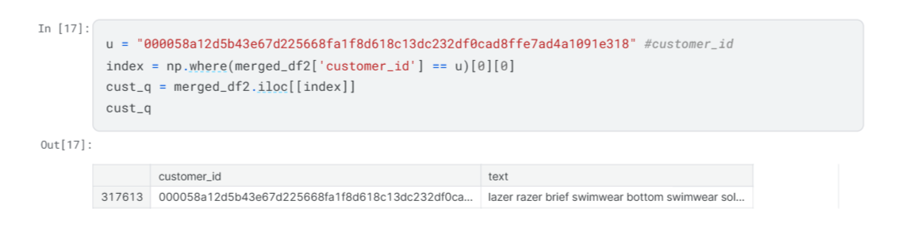
A random customer_id was chosen to make a reccommendation

Slide 10
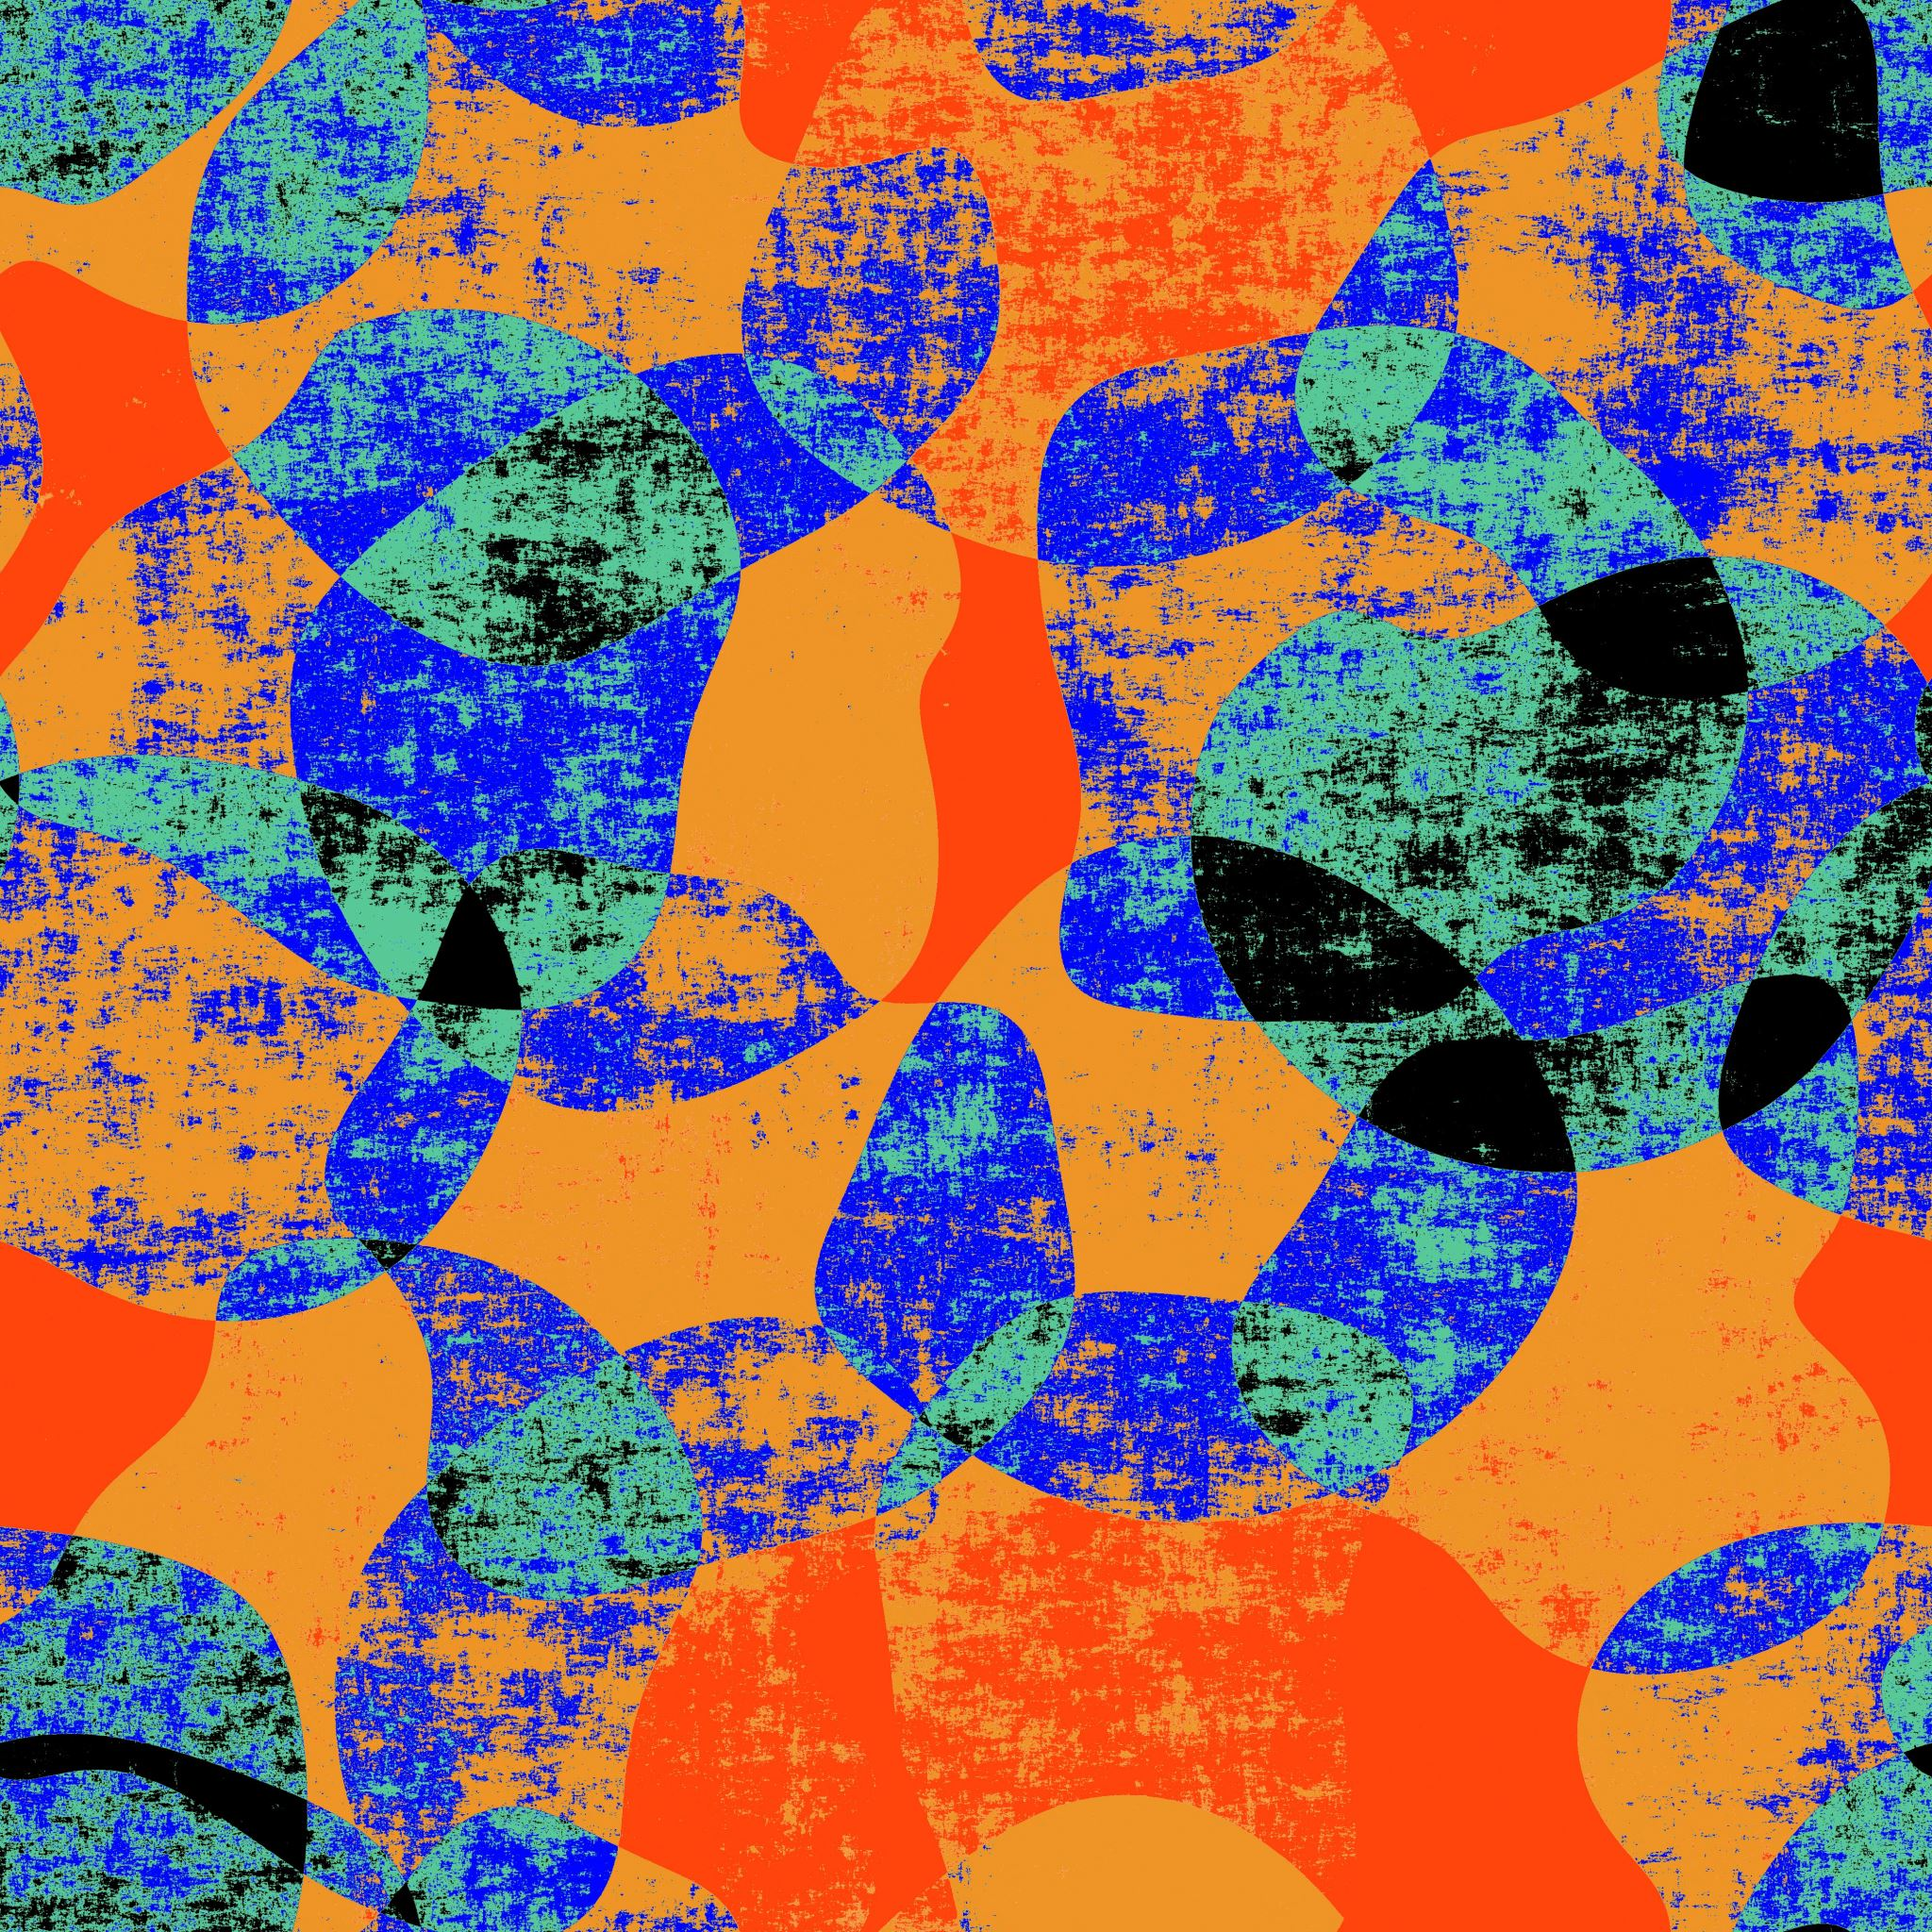
Query processing

Slide 11
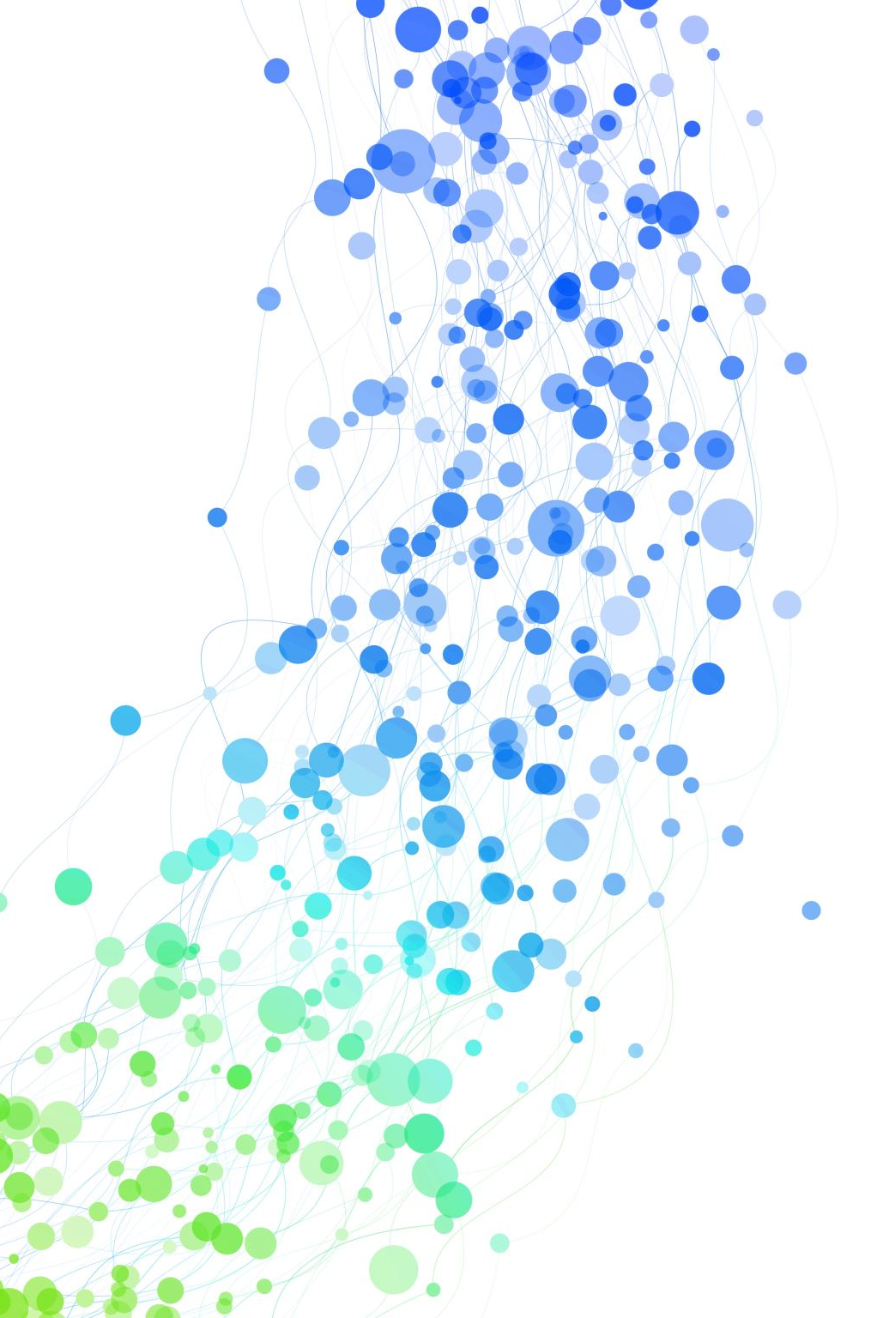
Levenshtein Distance
SpellChecker
manual_corrections
Translation
Duplicate
Expand within the Corpus (BERT MODEL)
Stemming (clean text stop words)

Slide 12
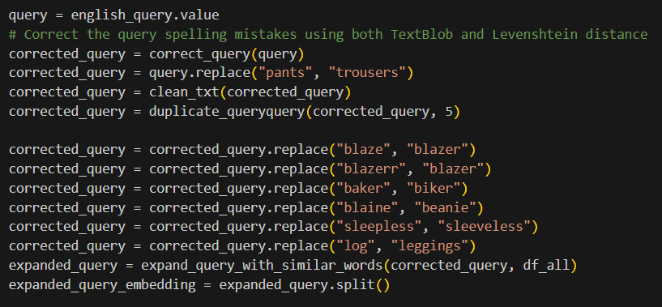
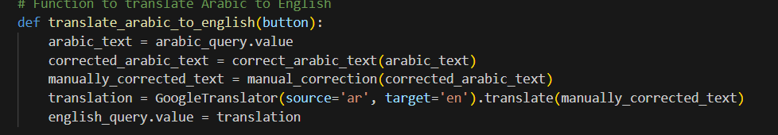
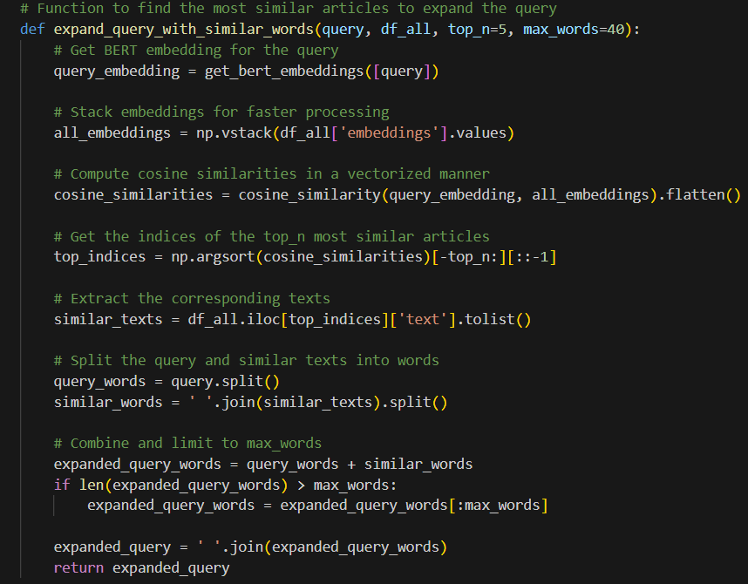
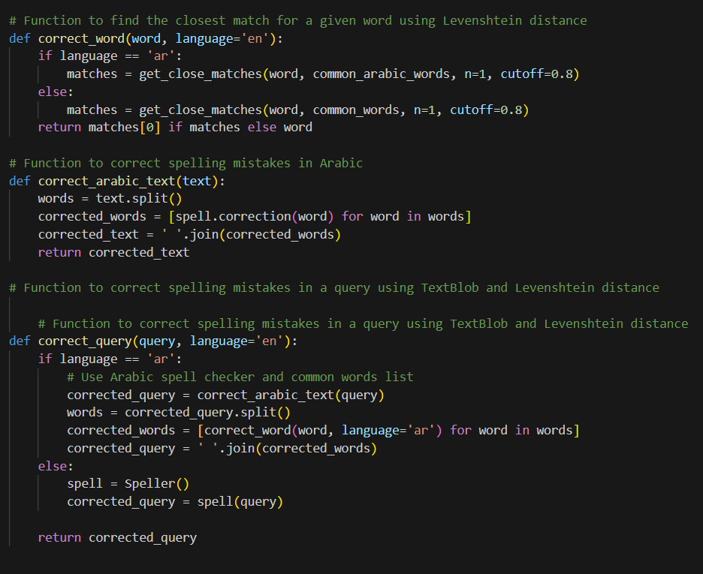
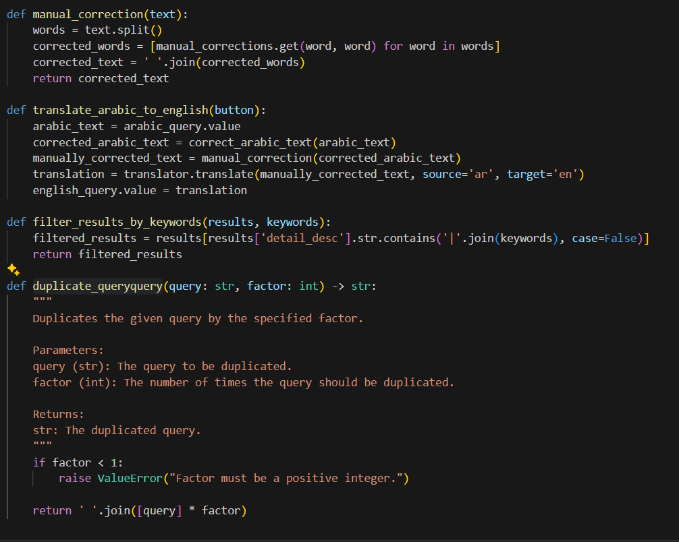

Slide 13
Recommendation models
Bert model
TfIDF model
KNN & count vectorize

Slide 14
Bert model
Query recommendation BERT
Query and past purchase recommendation BERT

Slide 15
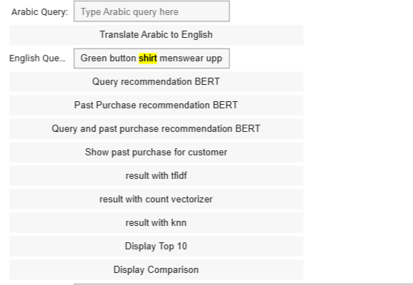
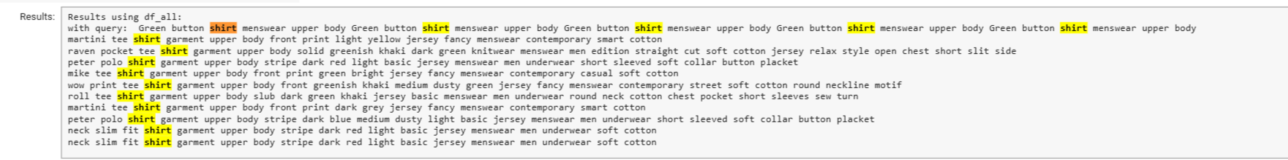
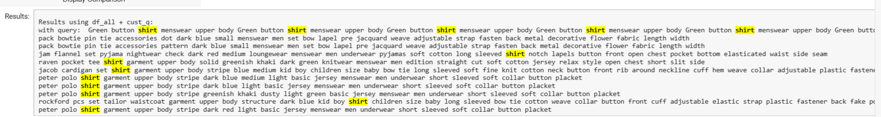
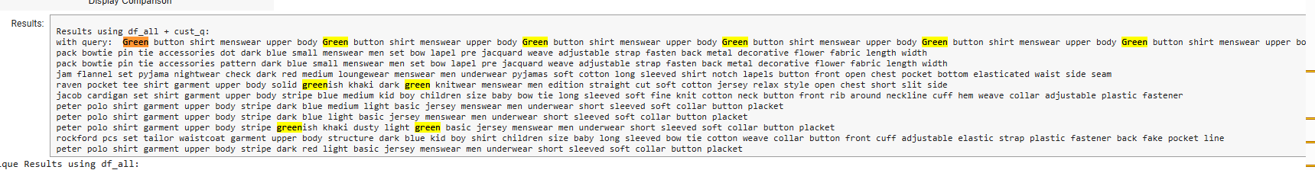
Test case
Bert model

Slide 16
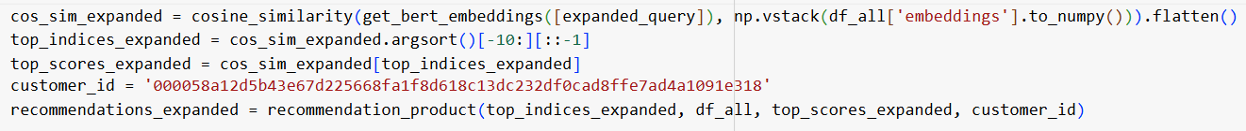
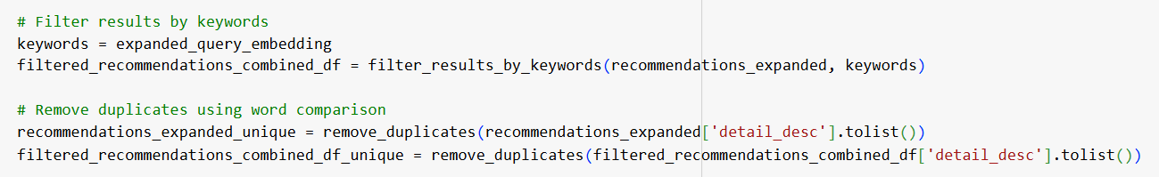
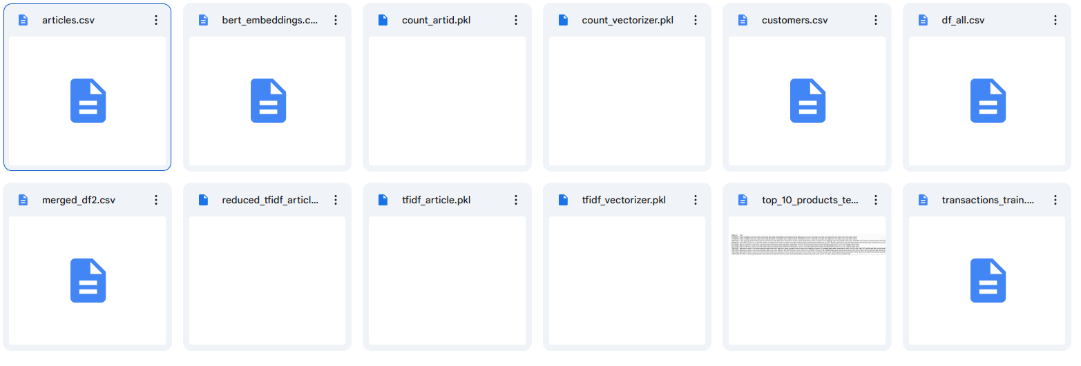
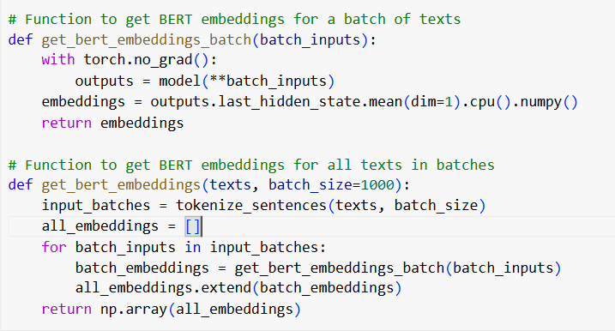
Code query search
Pretrained parameters

Slide 17
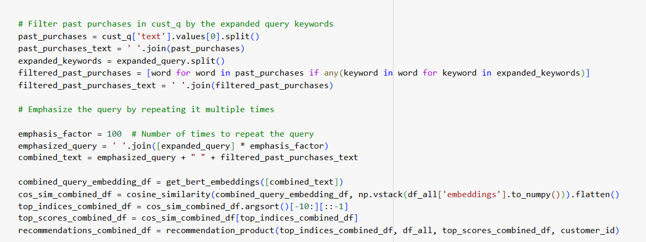
Code Query & Past purchase

Slide 18
TfIDF model

Slide 19
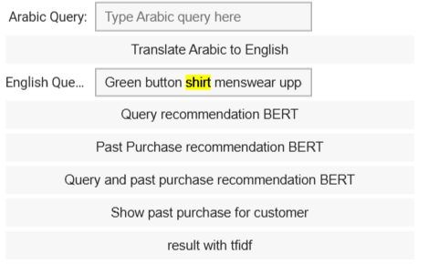
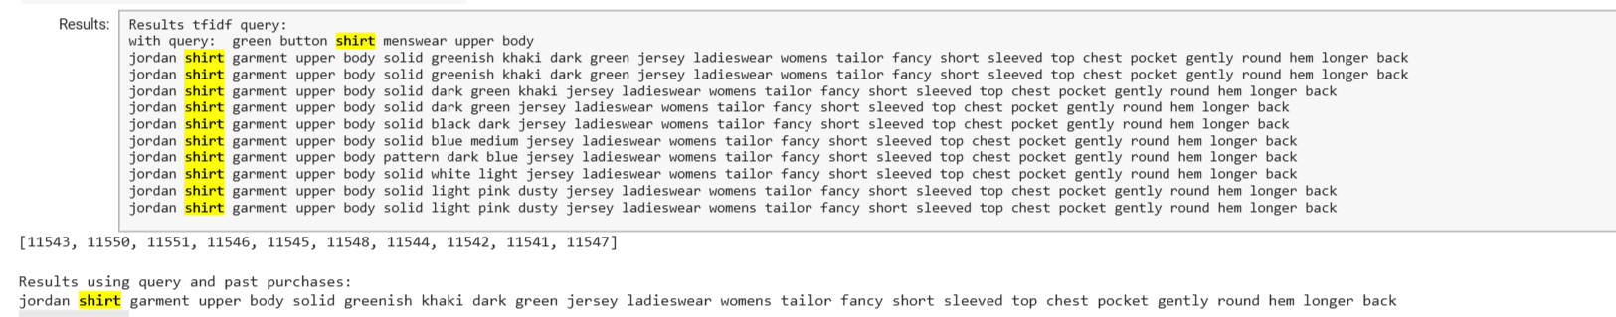
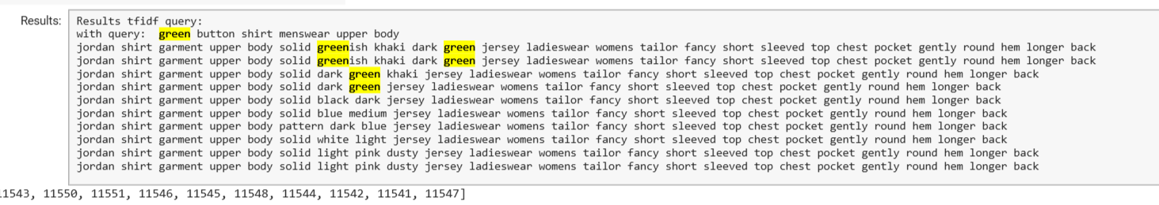
Test case
TFIDF

Slide 20
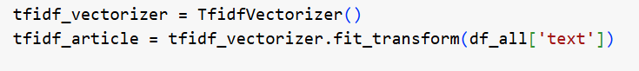
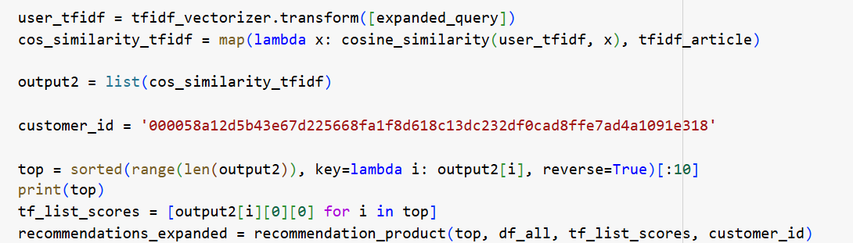
Code
Pretrained parameters

Slide 21
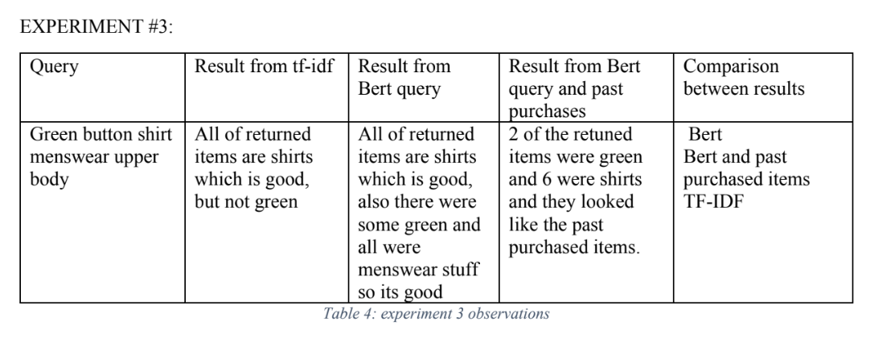
Evaluation

Slide 22
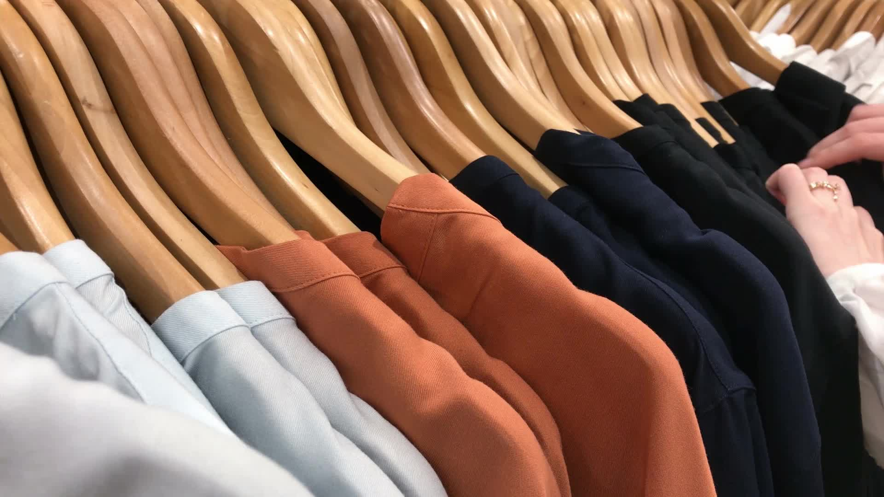
Other good models which give also good similar results
result with count vectorizer
result with knn
For general search without Query we provide :
Display Top 10
Past Purchase recommendation BERT

Slide 23
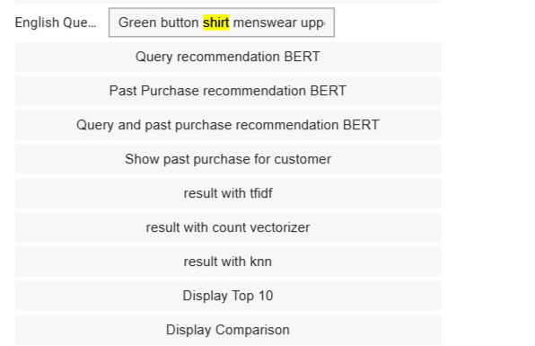
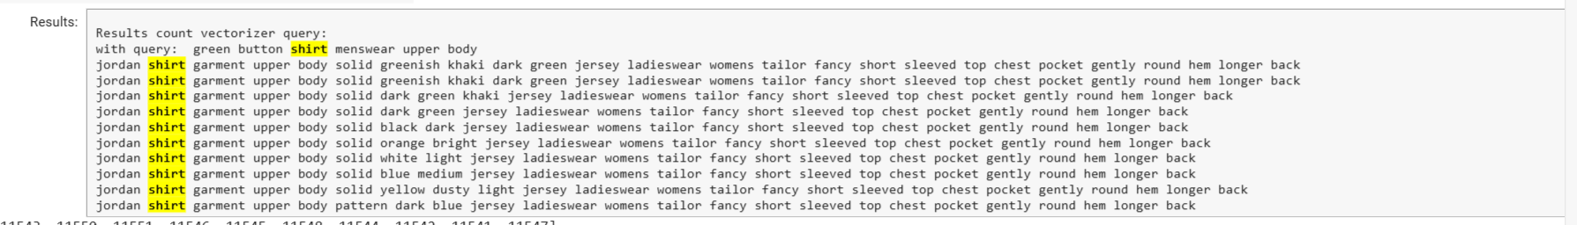
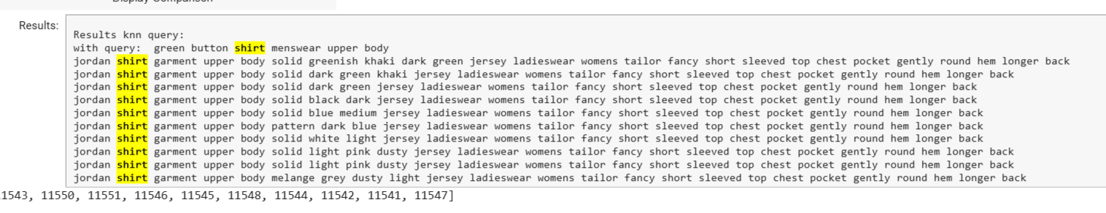
Test case
KNN & count
Count vectorizer
KNN

Slide 24
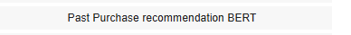
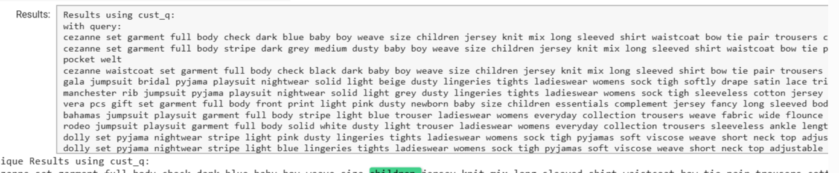
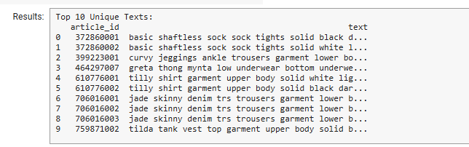
General search without Query.
Best result according to past purchase
Sample of what user used to buy :
These top ten products the which users buy

Slide 25
THANK YOU
JAL Recommendation Clothing System
Jana Herzallah 1201139
Ahmed Zubaidia 1200105
Lana Thabit 1200071

